Slide 1
DocIntel: AI-Powered Document Analyzer
Automate Document Understanding with Azure AI
Developers
Amandeep Sandhu & Sanskriti

Slide 2
Problem Statement
Manual document analysis is time-consuming, error-prone, and inconsistent.
Business/legal/financial documents often come unstructured or scanned.
Enterprises lack tools to extract meaningful, structured insights from files.

Slide 3
Project Overview
Project Name: DocIntel
Goal: Intelligent document analysis using AI + Azure
Use Case: Legal, HR, Financial document extraction and Q&A

Slide 4
Solution Overview
✅ Azure Form Recognizer to extract structured data (Key-Value pairs, tables)
✅ Azure OpenAI embeddings to chunk & semantically analyze text
✅ Custom Spring Boot backend to orchestrate the pipeline
✅ Angular frontend to present results interactively

Slide 5
Full System Architecture
Azure Form Recognizer (Document Intelligence)
Azure OpenAI (Embeddings, GPT-4 Turbo)
Spring Boot REST API
Angular 17 Frontend
Enhanced Chunking Logic
Real-Time Q&A via chunk-based question answering

Slide 6
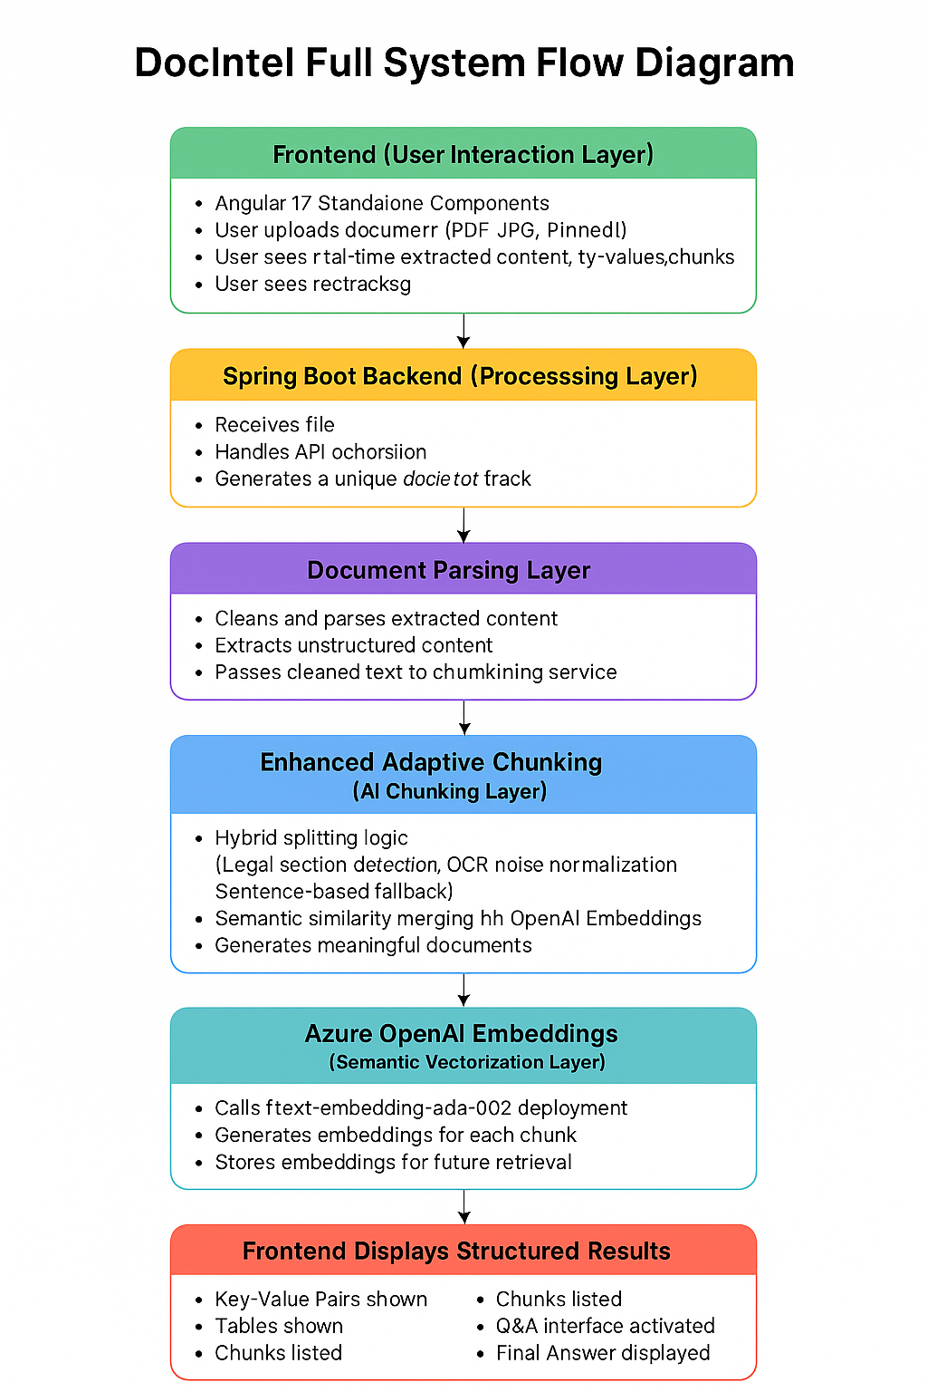

Slide 7
Key Features
🔥 AI-powered adaptive chunking
🔥 Embedding-based chunk similarity merging
🔥 Document type flexibility: invoices, contracts, HR letters, NDAs
🔥 Q&A on specific document sections
🔥 Works on scanned images + PDFs
🔥 Clean frontend with interactive UX

Slide 8
Tech Stack
Layer | Tech
Frontend | Angular 17, TypeScript
Backend | Java 17, Spring Boot 3
AI | Azure Form Recognizer, Azure OpenAI (Embeddings + GPT-4 Turbo)
Cloud | Azure
Language Models | text-embedding-ada-002, gpt-35-turbo
Infrastructure | REST API, JSON DTOs

Slide 9
Challenges & Solutions
Challenge | Solution
Noisy OCR data | Smart normalization + regex preprocessing
Mixed structure (tables + free text) | Form Recognizer hybrid extraction
Chunking long documents | Adaptive chunking with embedding similarity
User experience | Dynamic chunk selection & interactive Q&A

Slide 10
Future Enhancements
🔮 Named Entity Recognition (NER) on unstructured text
🔮 Entity highlight on UI
🔮 Full document summarization
🔮 Advanced semantic search across documents
🔮 Document version comparisons
🔮 User feedback loop to improve ML pipeline

Slide 11
Target Users
📑 Legal teams (contract analysis)
💼 HR departments (offer letters, compliance)
📄 Finance teams (invoices, audits)
📊 Enterprise document intelligence solutions
🏢 Consulting & AI-powered automation providers

Slide 12
Project
File Upload → Analyze → Auto-Chunk → Display → Q&A
[ Chunk Viewer] → [ Ask a Question] → [ Get Answer]

Slide 13
Project Demo
GitHub repo link: https://github.com/amandeepsandhu13/docintel
Demo : please watch video

Slide 14
Thank you for reviewing our project!
Let’s responsibly automate document understanding with AI.

